Slide 1

Heaven’s light is our guide
Rajshahi University of Engineering & Technology
Department of Mechatronics Engineering
Presentation on
Personal Finance Manager
App Name: Personal Expense Manager
Course No.: CSE- 2188
Course Title: Software Engineering Sessional
Group - 03

Slide 2
Group-3 Members:
1908011 - Rashed Al Sibgatullah
1908013 - MD Shahadat Hossain
1908014 - Shirsa Saha Avro
1908015 - F.M. Rezwan Parvez
1908016 - Md. Hasin Motawassamin
Under The Supervision of:
Md. Faisal Rahman Badal
Lecturer
Dept. of Mechatronics Engineering
Rajshahi University of Engineering & Technology
Md. Mehedi Hasan
Lecturer
Dept. of Mechatronics Engineering
Rajshahi University of Engineering & Technology

Slide 3
Table of Contents:
Introduction
Platform, Tools and Language
Features
Layout
Demonstration Video
Limitations
Bugs

Slide 4

Introduction:
Personal Expense Manager is an Android application to manage daily income and expenditure.
Personal Expense Manager

Slide 5




Platform, Tools and Language:

Slide 6
Features:
Registration and login using Email and password
Add income and expenses with short details
Update and delete income and expense information
Show stats comparing income and expenses

Slide 7
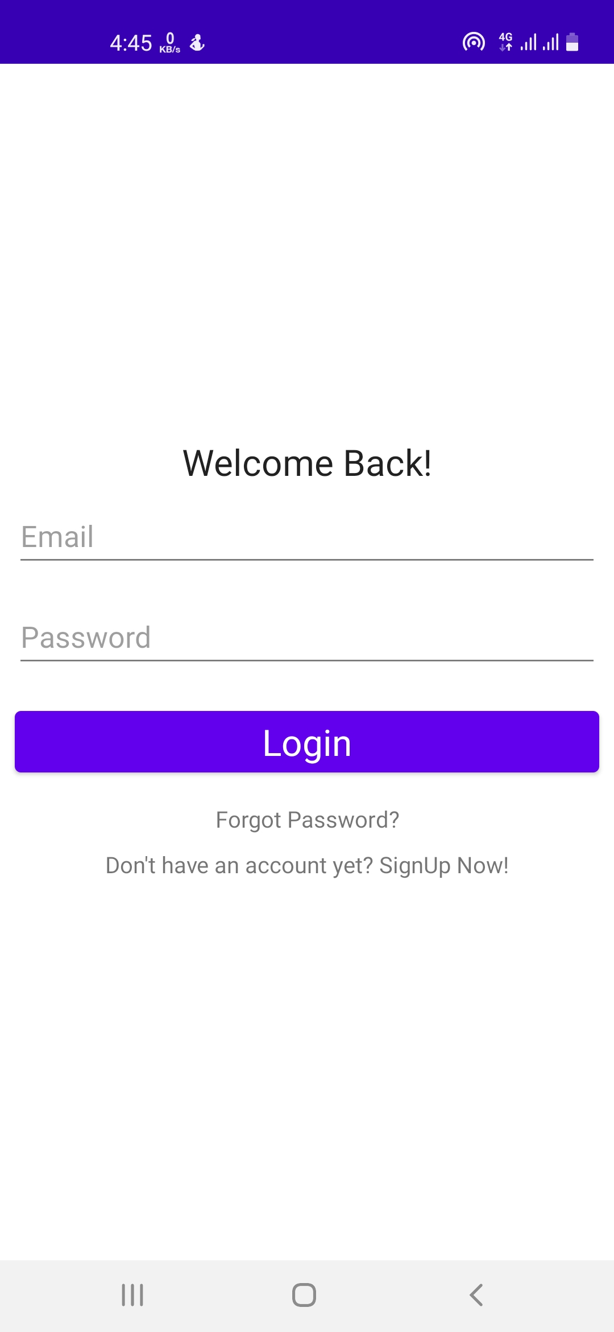
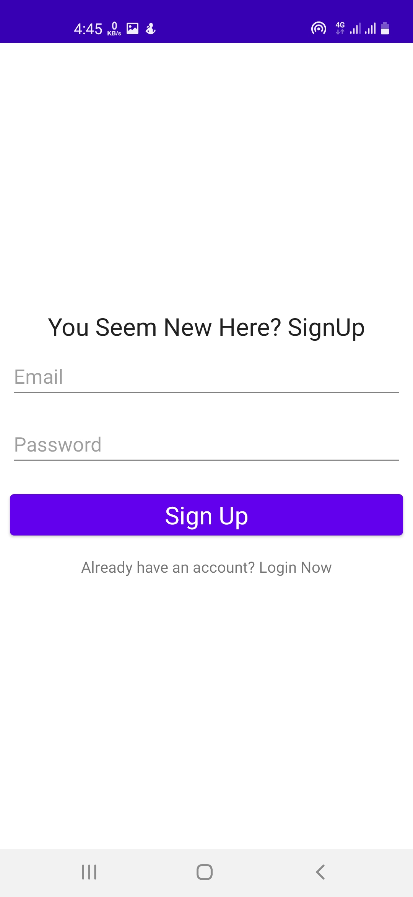
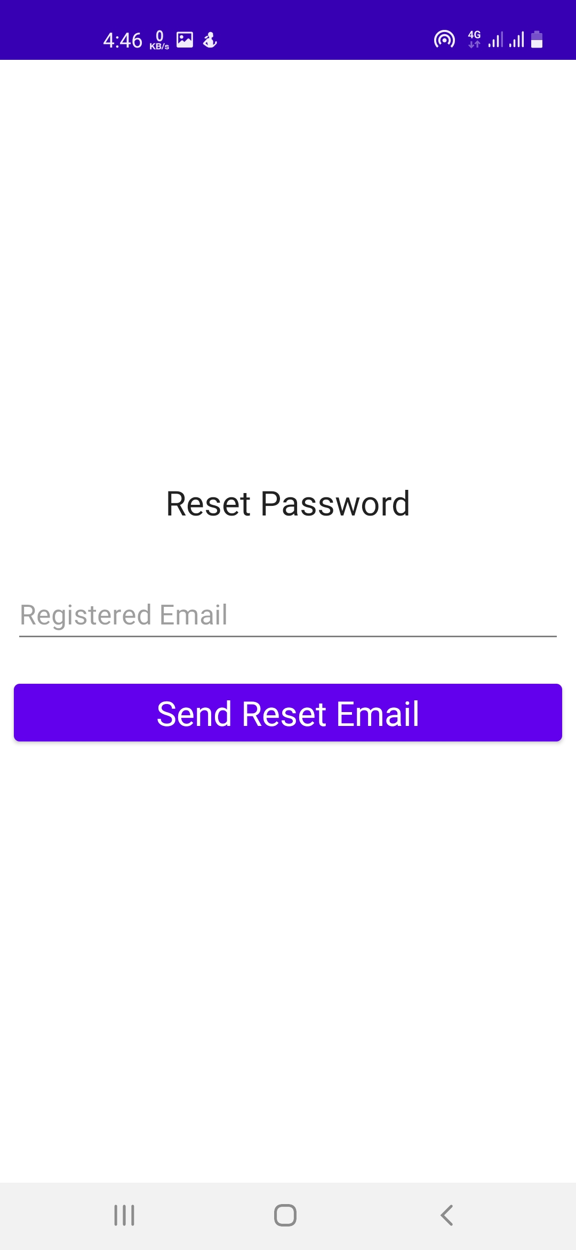
Layouts:
Login Page
Registration Page
Forgot Password Page

Slide 8
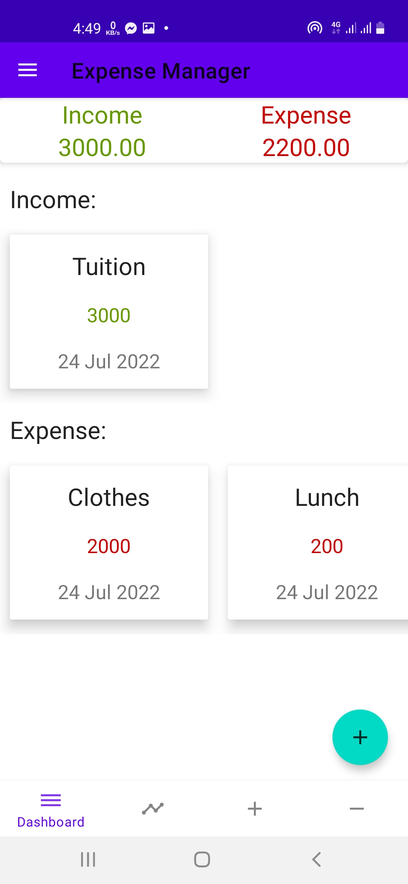
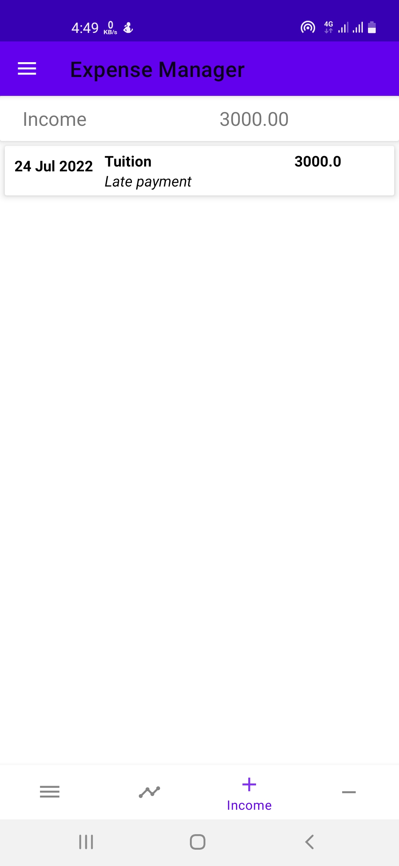
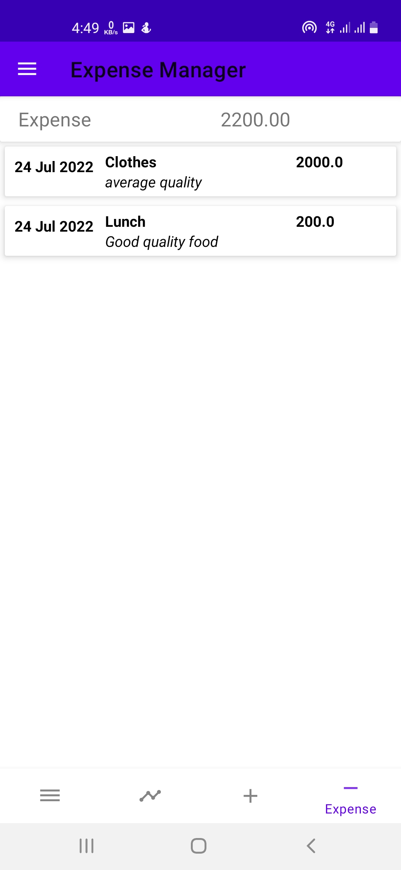
Layouts:
Dashboard
Income Details
Expense Details

Slide 9
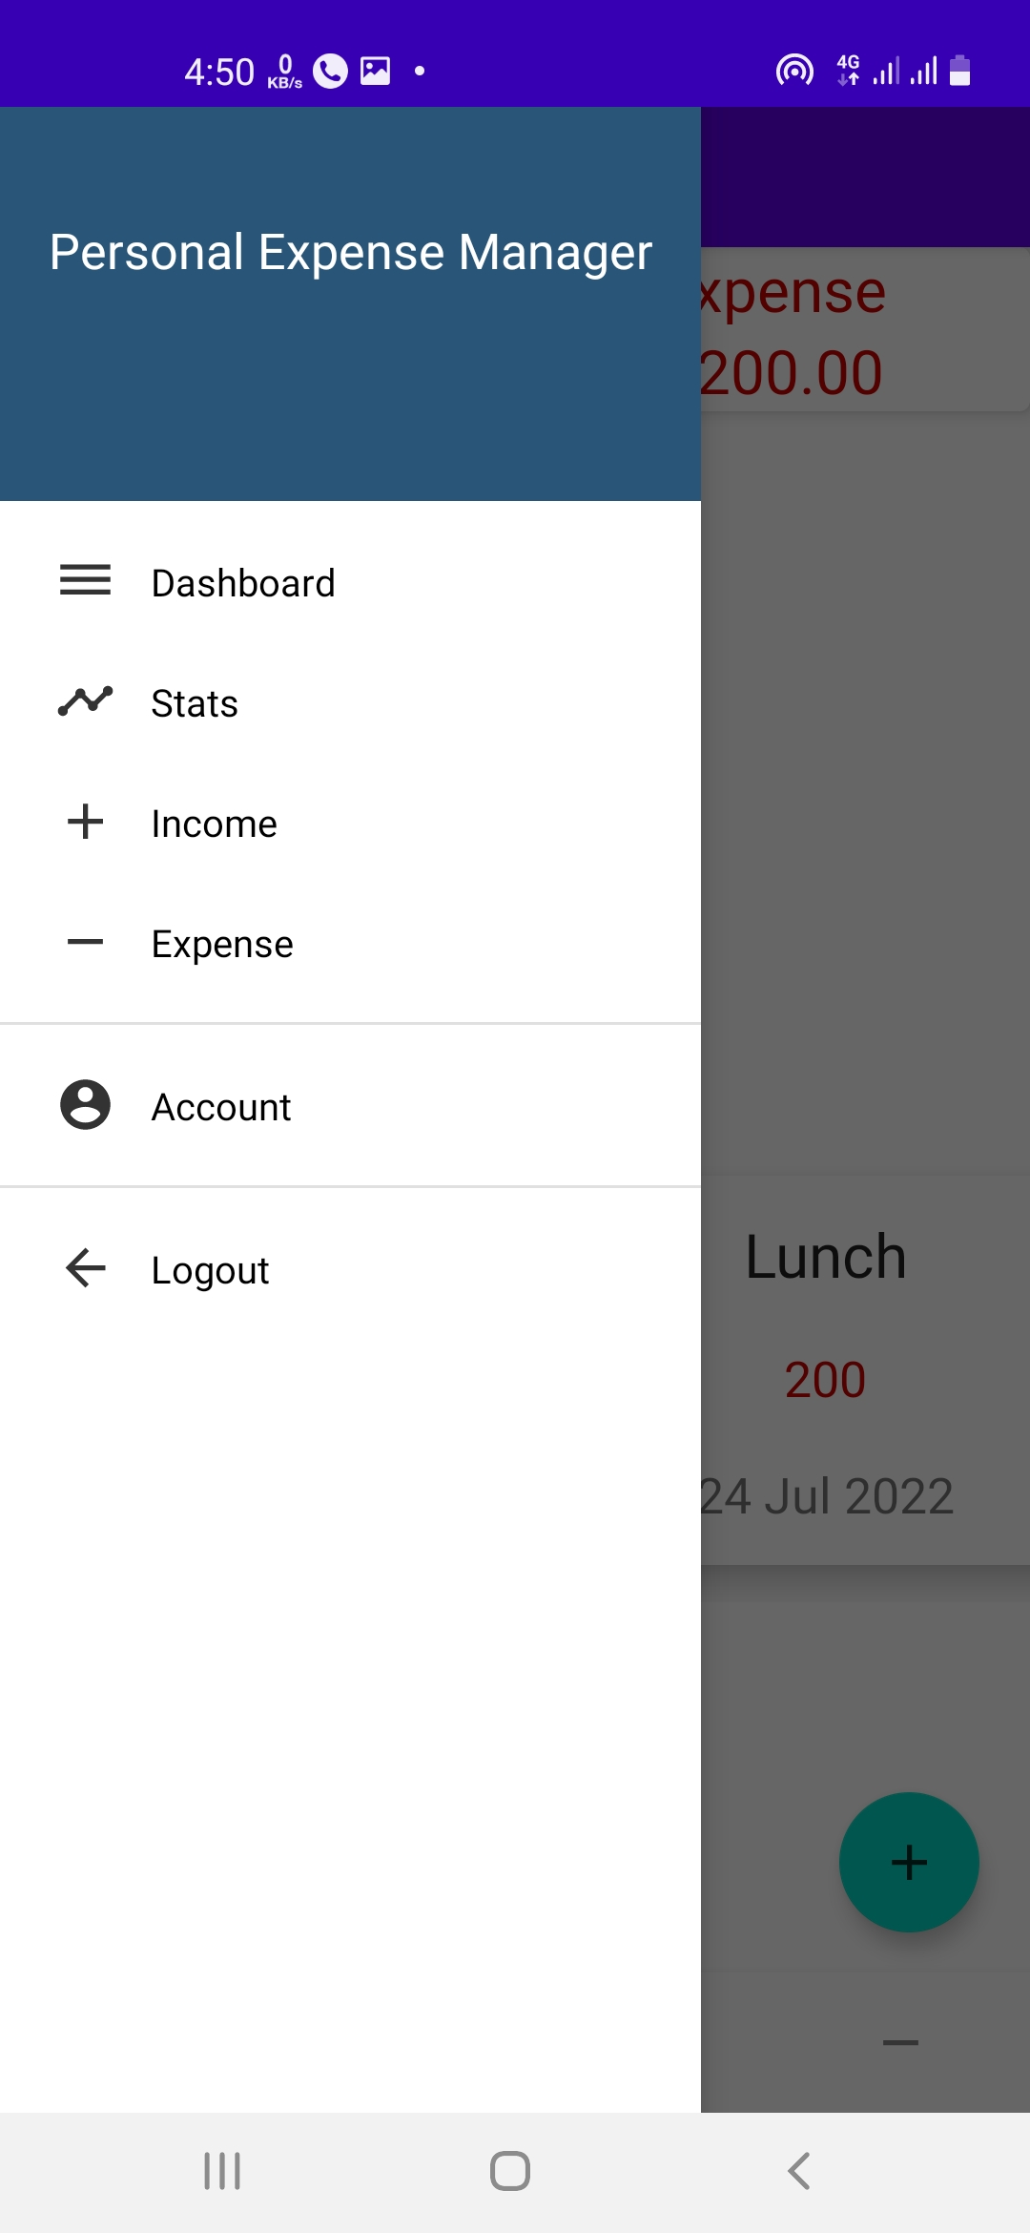
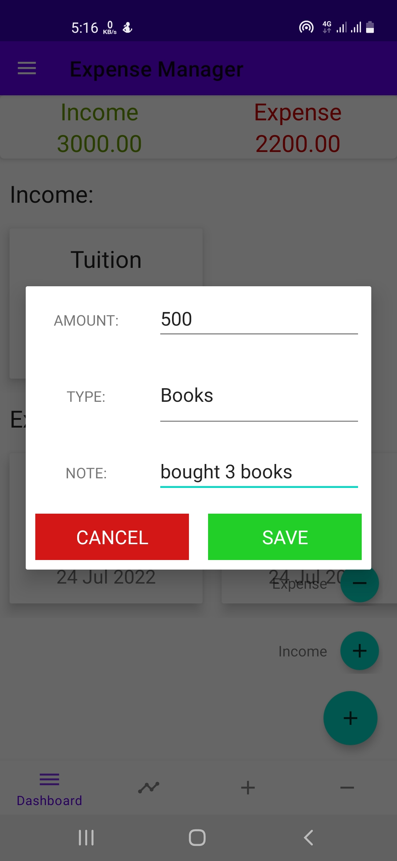
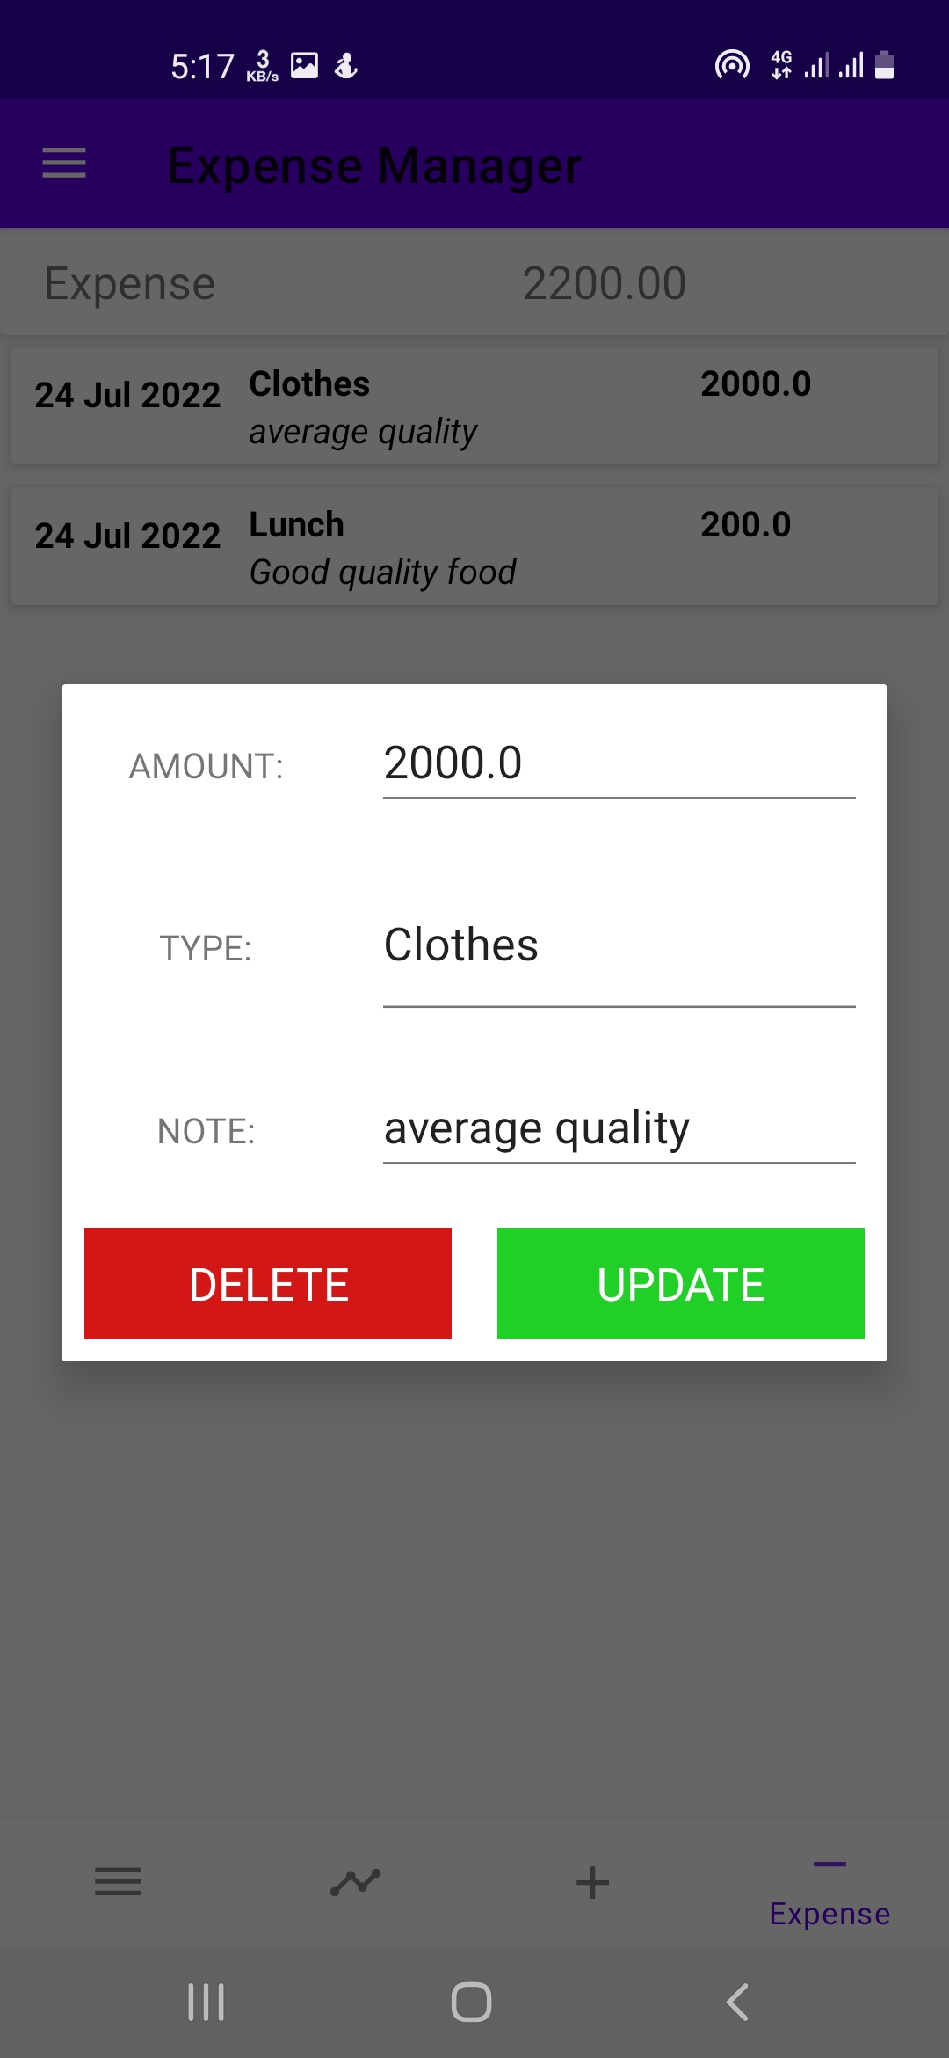
Layouts:
Menu
Insert Info Layout
Update Info Layout

Slide 10

Demonstration Videos:

Slide 11
Limitations:
No budget planning option
No daily, weekly, monthly analytics
Reset password option isn’t functional

Slide 12
Bugs :
The app immediately shuts down after opening ‘Stats’ page
Can’t update ‘Notes’, App immediately shuts down
We can’t install the app using apk file, we need to use our phone as virtual device in android studio in order to install the app
App forces shut down if we write something other than any number in ‘Amount’ option

Slide 13
THANK YOU!

